Slide 1
How might we…? Framer
Challenge

Slide 2
How might we…? Framer
Why?
Challenge

Slide 3
How might we…? Framer
Why?
Challenge
How?

Slide 4
How might we…? Framer
Why?
HMW 1?
Challenge
HMW 2?
How?
HMW 3?

Slide 5
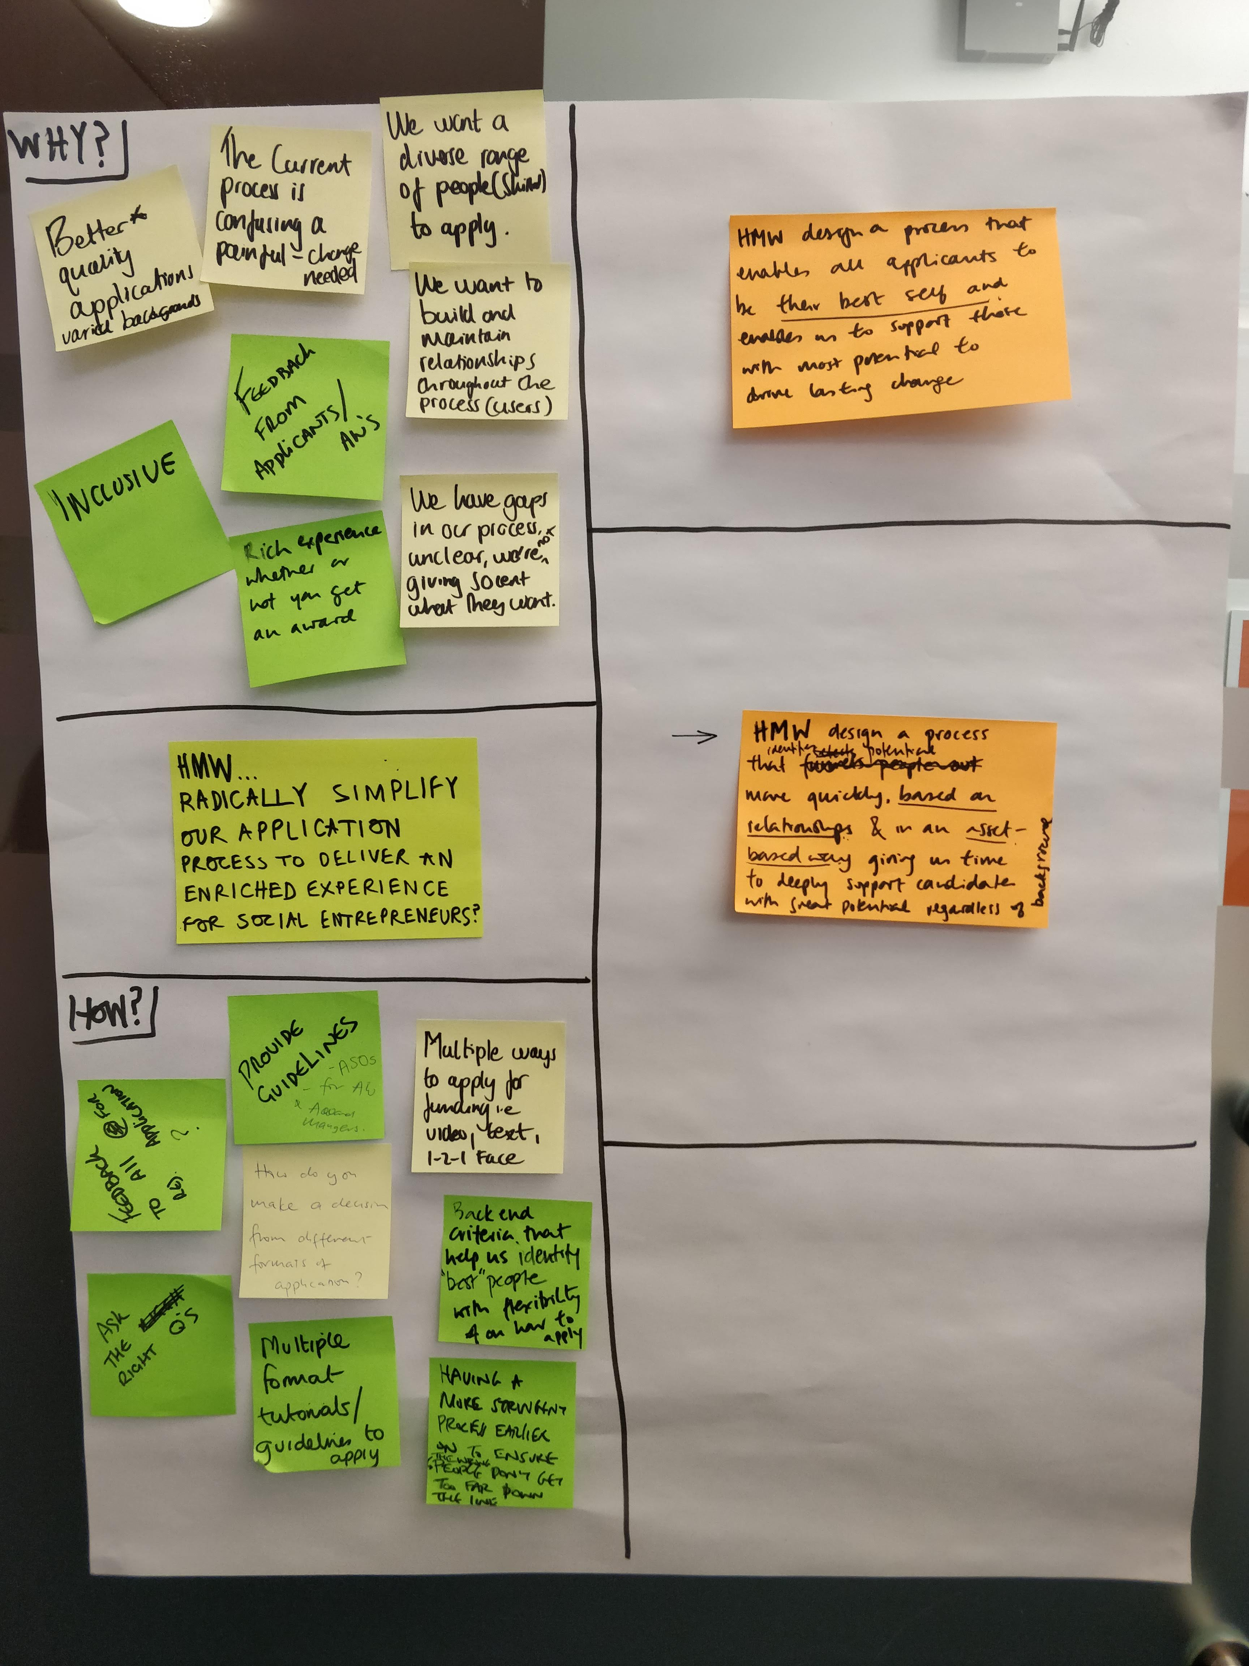
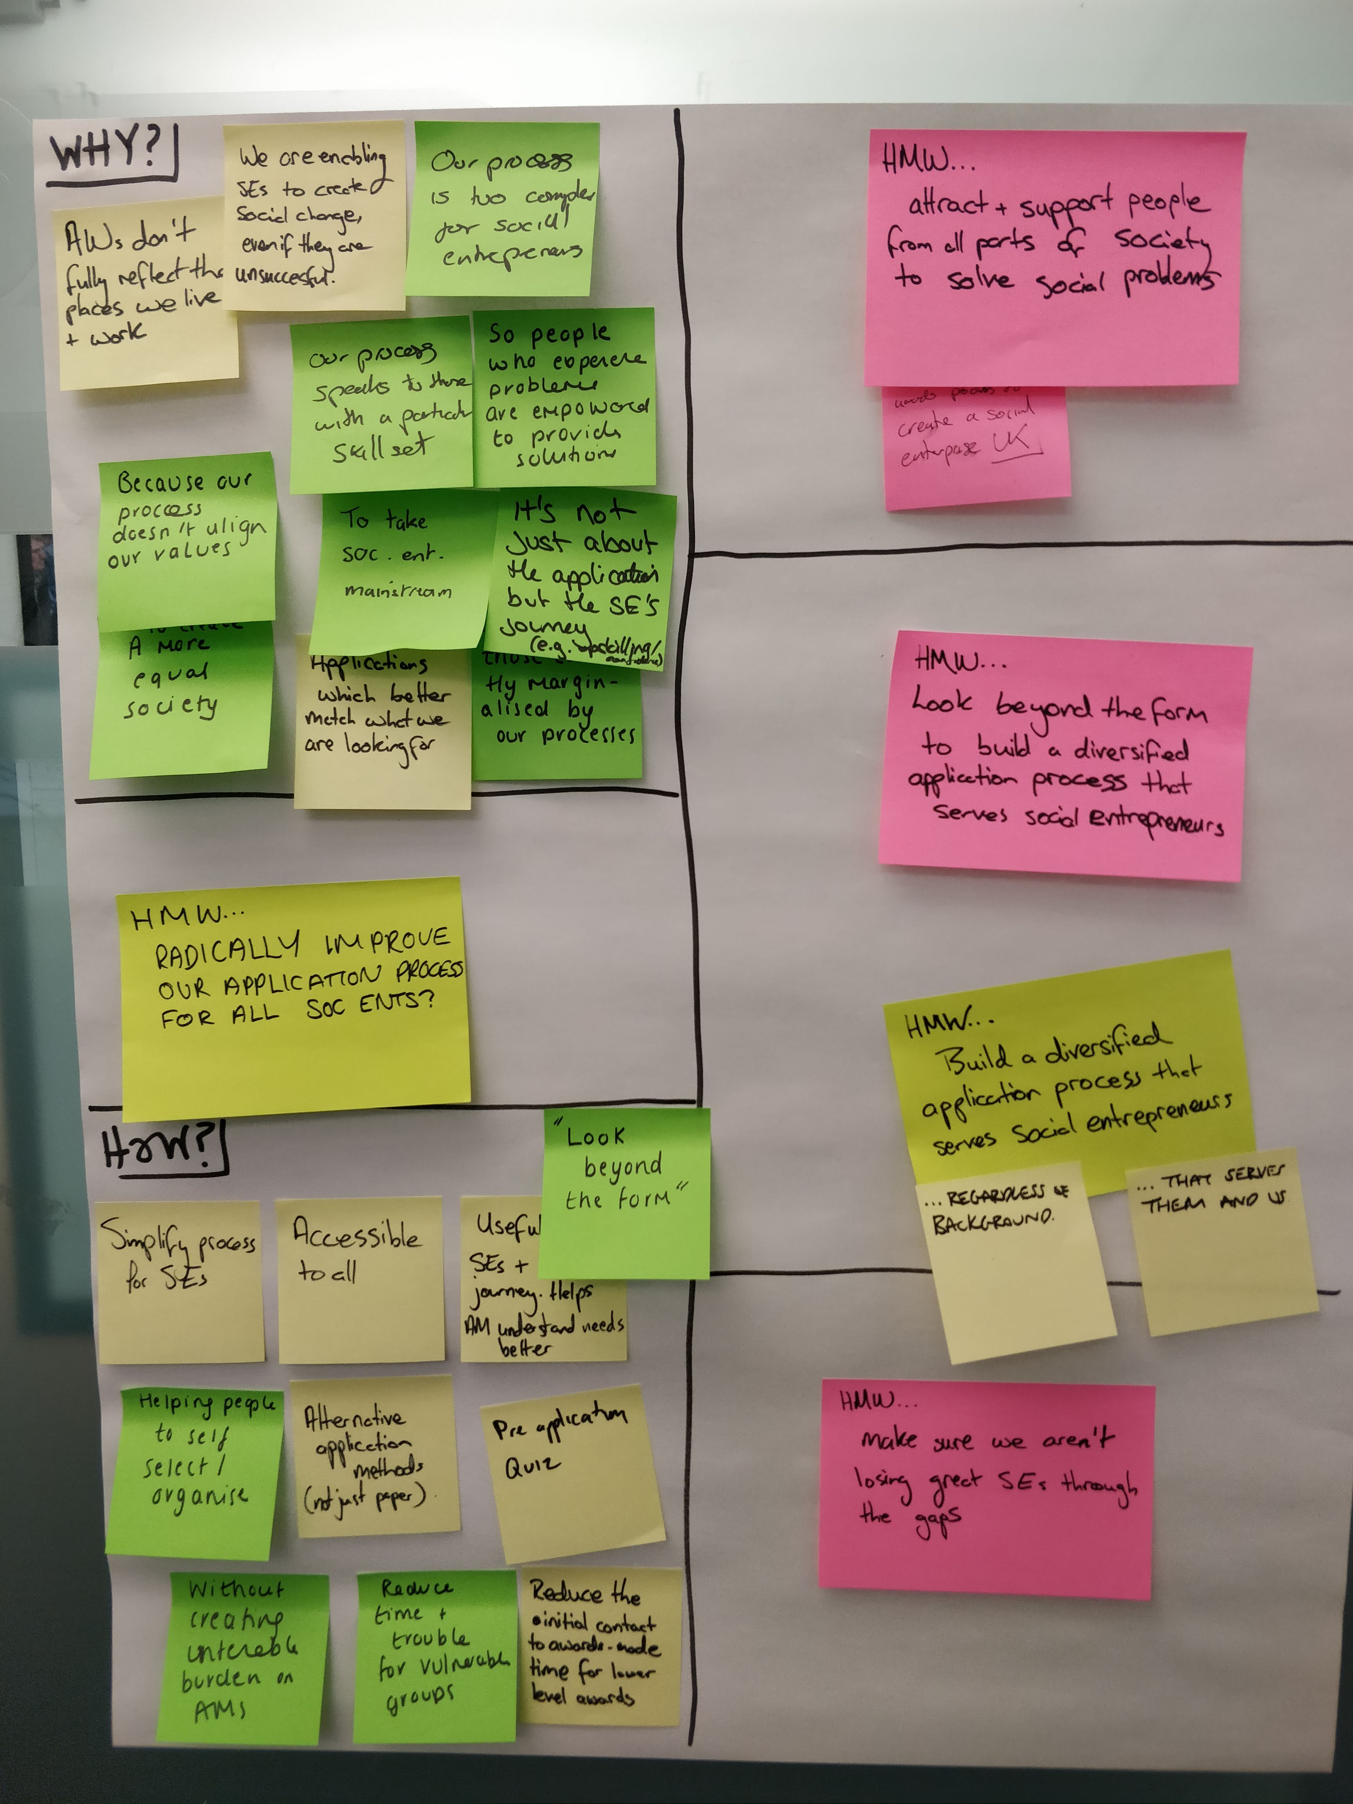
How might we…? Framer

Slide 6
How might we…? Framer
“Build an application process which reflects the diverse needs of our applicants regardless of their background; providing a positive experience, and a useful platform for us to identify individuals with great entrepreneurial solutions to social issues.”

Slide 8

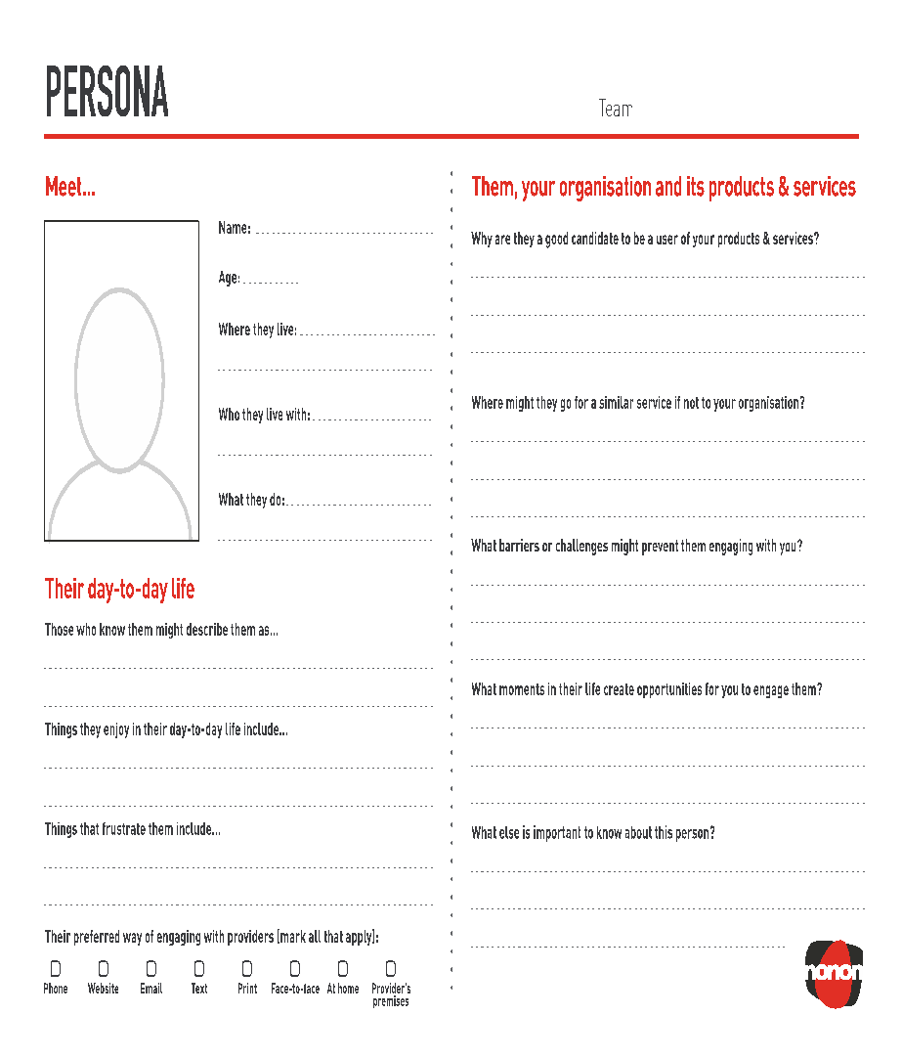
Social entrepreneur type: Unconscious Social Entrepreneur
PEN PORTRAIT
In one sentence: I’m already doing it! Now please help me deal with the fiddly bits I don’t understand
Meet…
What support do they need to grow as a venture/leader?
Name:
Harry
Need help with structuring, giving parameters and boarders
to their work
- Strategic development plan
Age:
41
Where they live:
Urban area of a big city
What barriers or challenges might prevent them from getting the most out of working with you?
Who they live with:
Their style / approach.
Realising what support is available
Lack of professional acumen
Partner & kids
What they do:
Self-employed
What’s their preferred way of receiving support and why?
Disability:
Ethnicity:
Black African
no
Face to face. Need to sit down and chat things through.
Background
Formal education:
Lived experience
None
GCSE
(or equivalent)
A-level
(or equivalent)
Undergrad
(or equivalent)
Postgrad
(or equivalent)
Low
High
Where might they go for similar help, if not UnLtd?
Here’s more information on my education
Voluntary services, local authorities, local schools, police services.
Maturity of enterprise: early stages,
Entrepreneurial experience:
What else is important to know about this person?
Low
High
UnLtd needs to know what support does he need?
My venture is sports club activities for local youth.

Slide 9
ONLINE
E.G. SLACK, WHATSAPP
E.G. FIXED/PRE-BOOKED, SKYPE, FACETIME
OFFLINE
E.G. ADHOC PHONECALLS
E.G. IN PERSON, FIXED FREQUENCY
UNSTRUCTURED
STRUCTURED

Slide 10

INTERVIEWING
“Why do you always answer a question with a question?”
“Why do you say that?”

Slide 11



Categorising research findings
Positive (highlights)
We’re doing great
Negative (low points)
We’re doing badly
Has potential
We’re doing ok, but could do better (ideas)

Slide 12
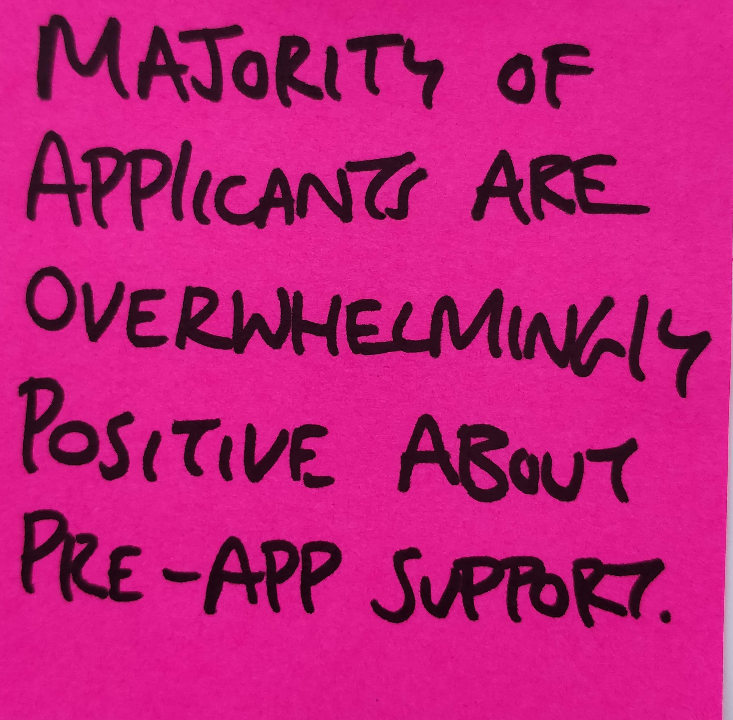
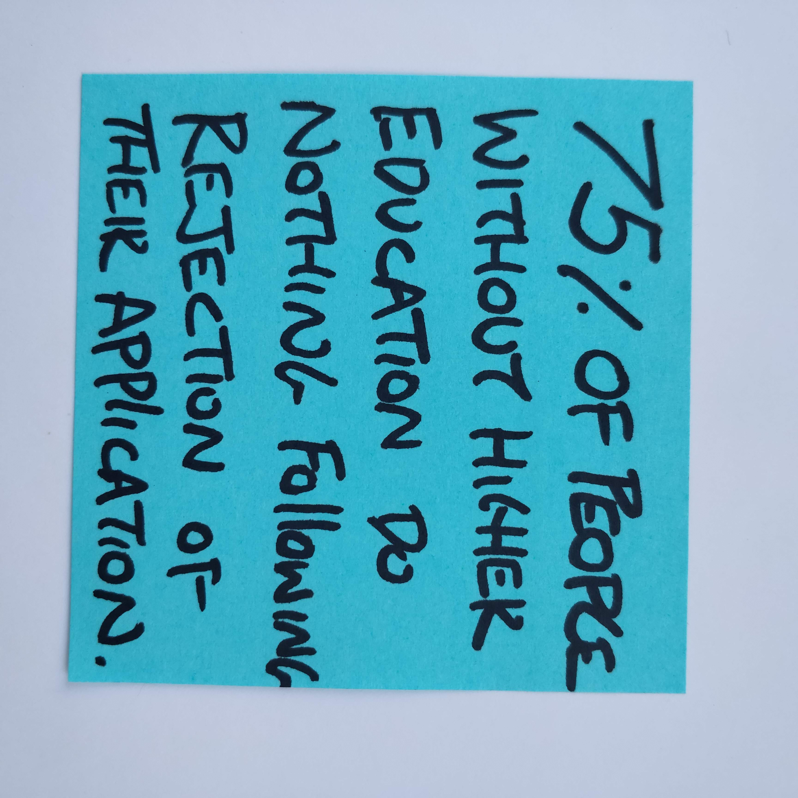
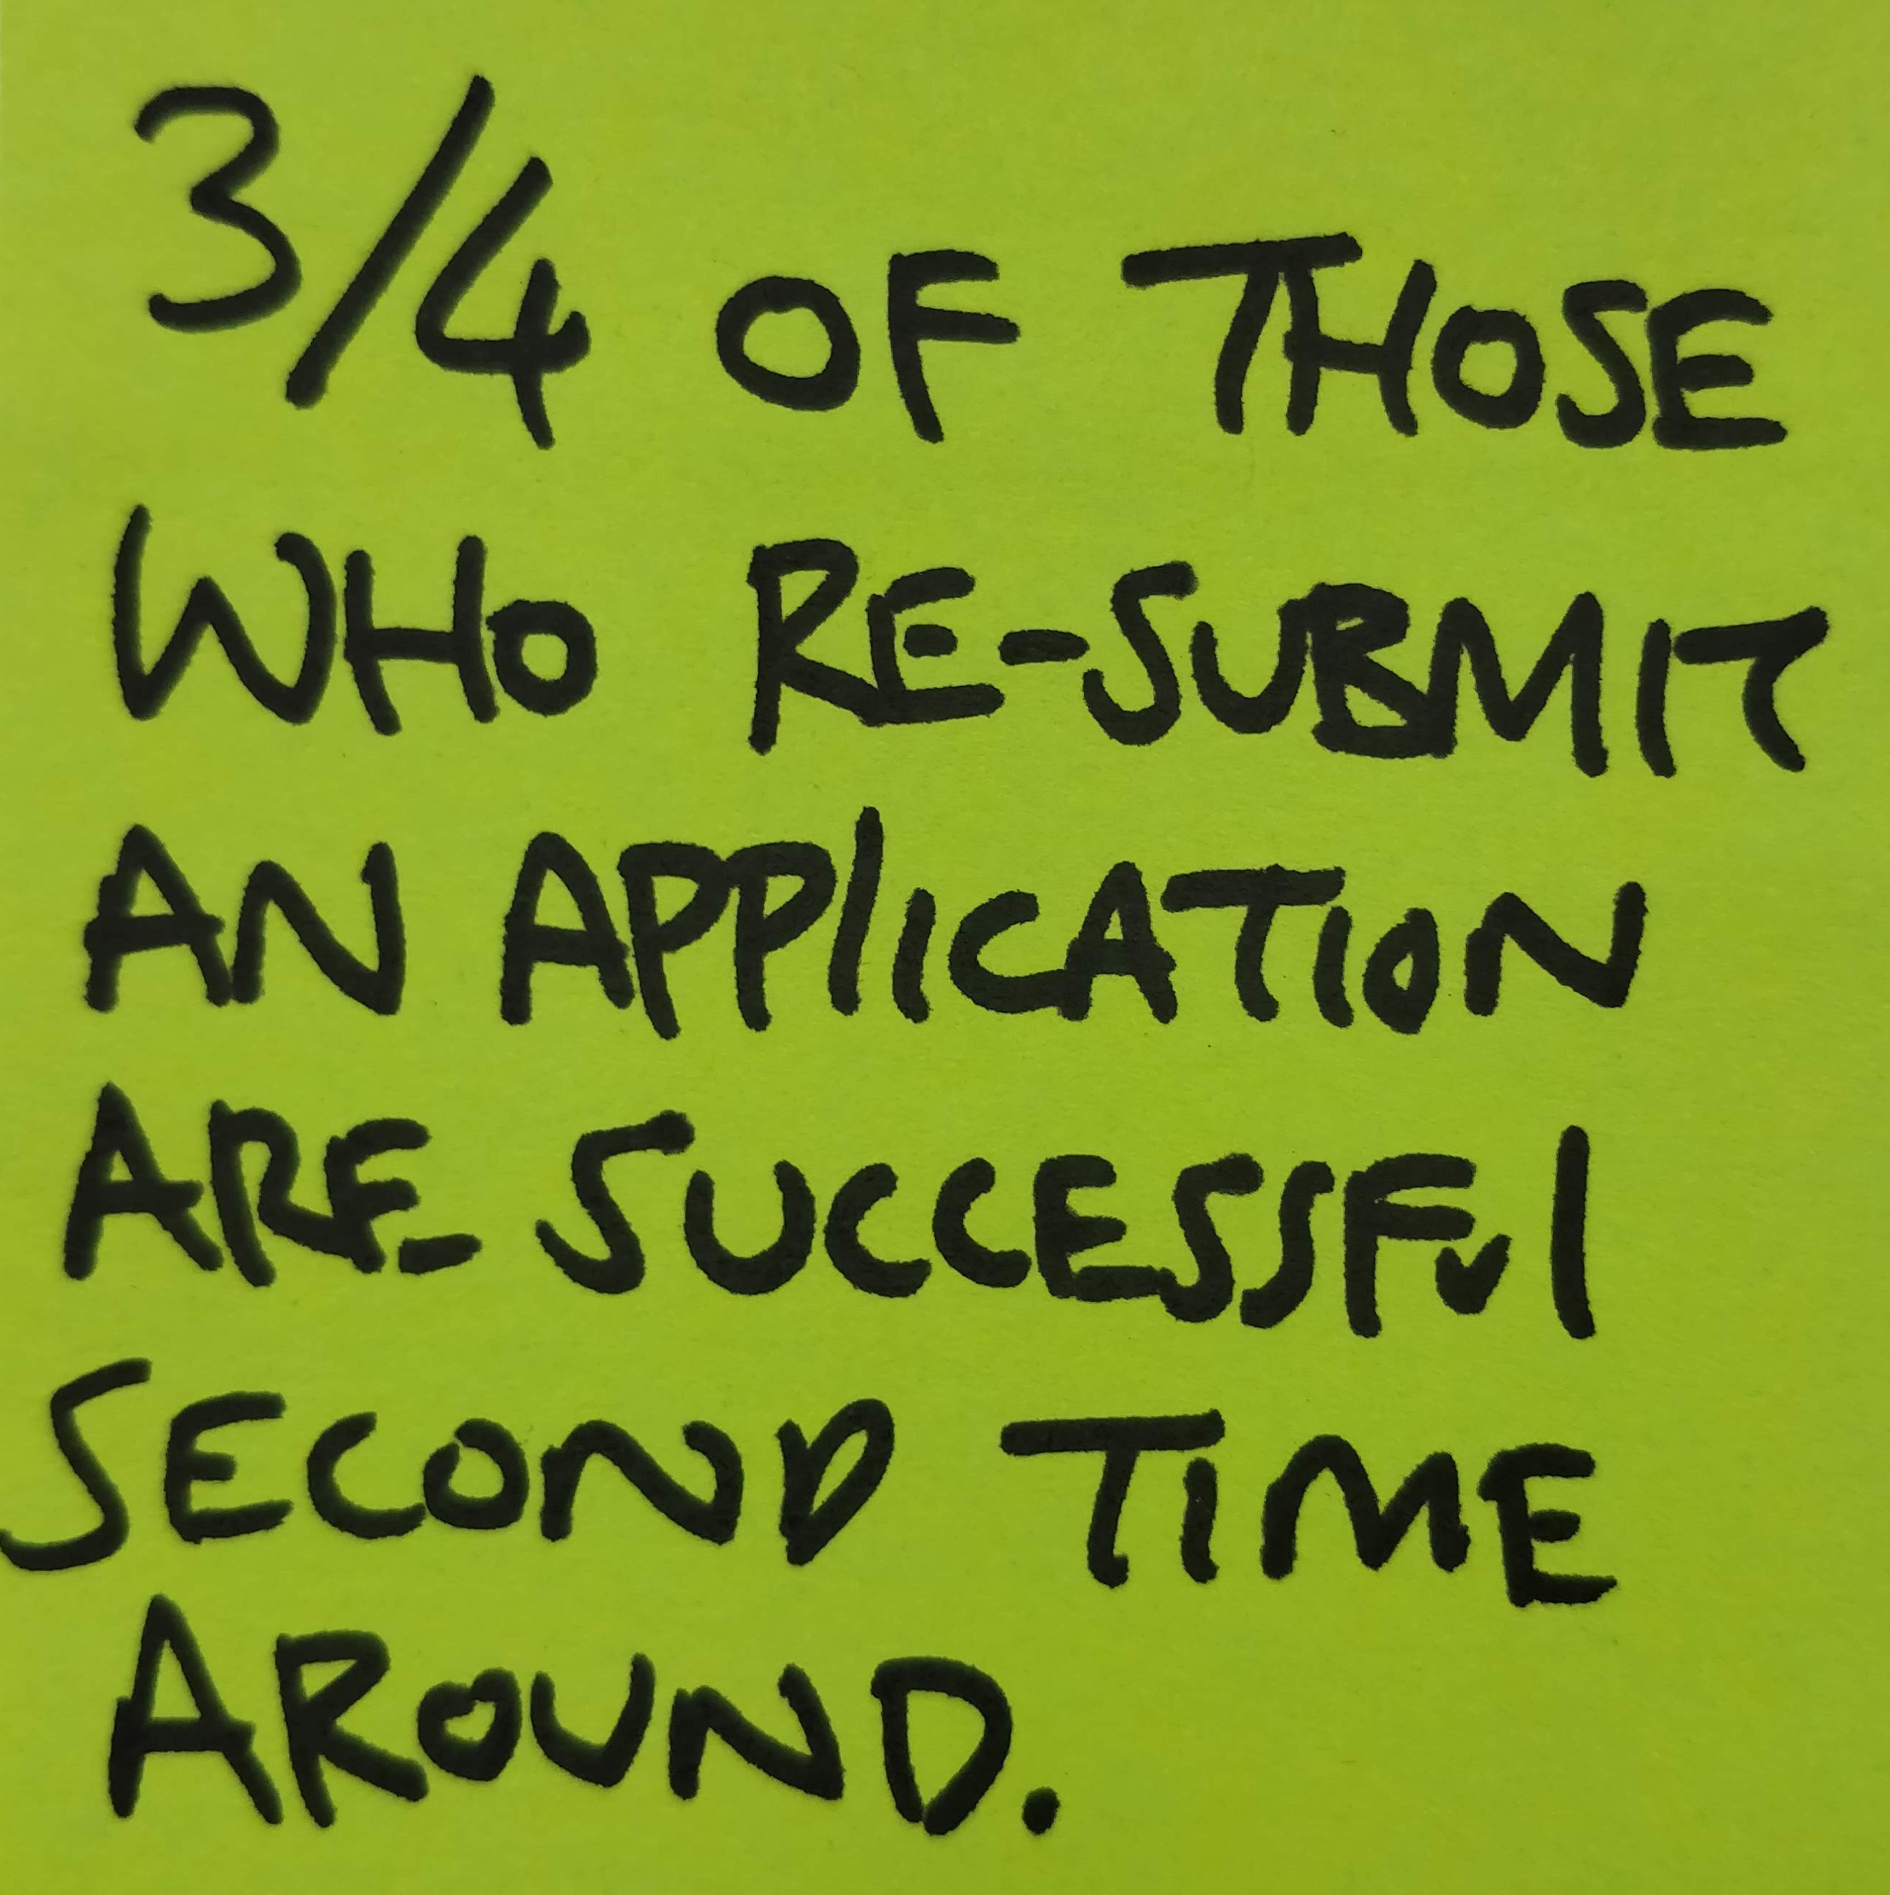
Categorising research findings
Positive (highlights)
We’re doing great
Negative (low points)
We’re doing badly
Has potential
We’re doing ok, but could do better (ideas)

Slide 13
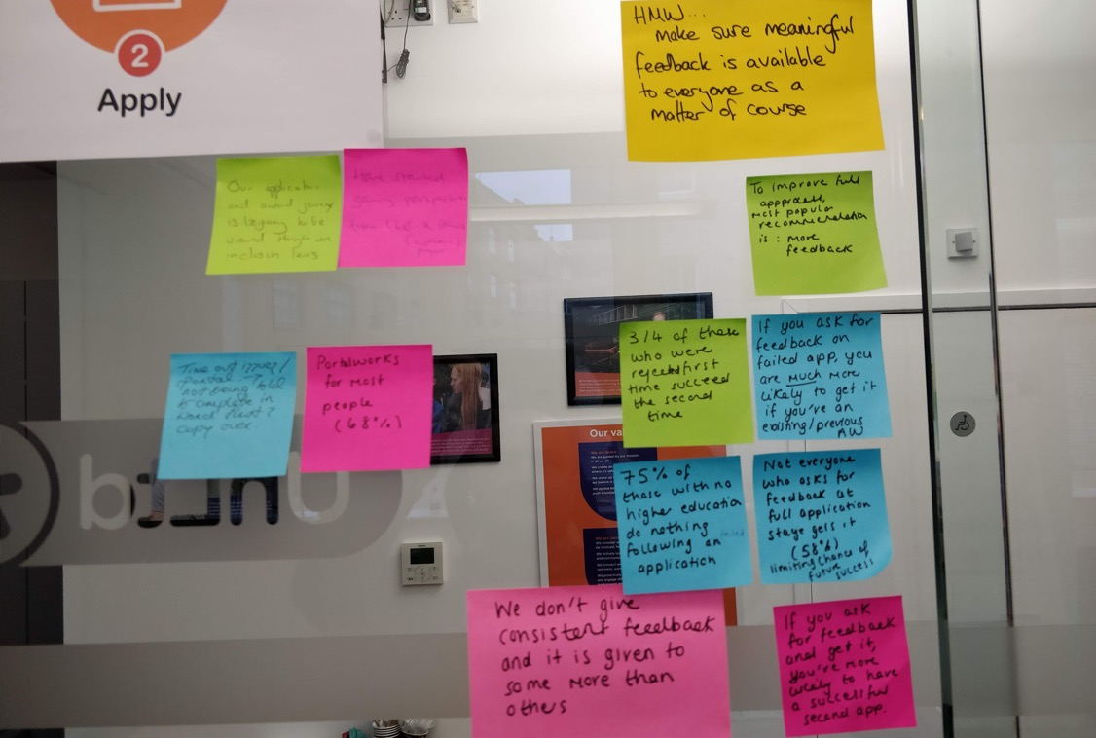
Categorising research findings

Slide 15
HMW 1?
HMW 2?
HMW 3?
HMW 4?

Slide 16
HMW 1?
HMW 2?
HMW 3?
HMW 4?

Slide 18
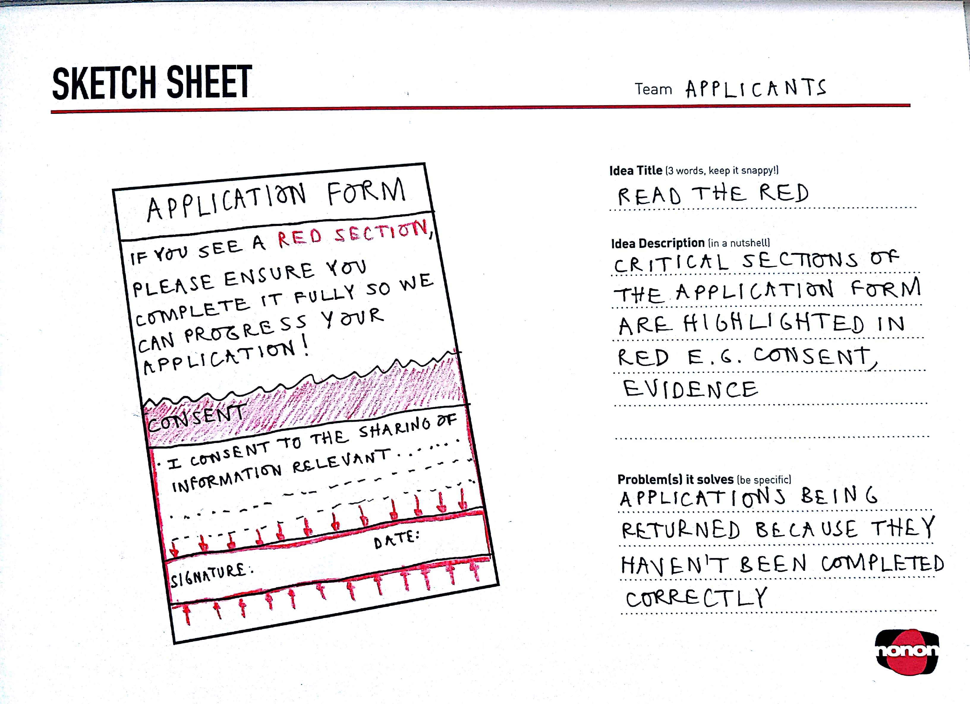

Slide 19

PITCH & BUILD
Sense of who the SE is
What they need
Why UnLtd should support them

